Slide 1
JAPAKEYS
a Programming Capstone Project
Group #4
Shawn Witter | Matt Walsh | Holly Franks
7 May 2018

Slide 2
The Problem
Learning a language: difficult and tedious
Many language learning apps cannot hold the user’s attention
How can we make learning a language engaging and fun?

Slide 3
The Proposal
Japakeys—An educational game designed to teach the user Japanese
Has some RPG(Role Playing Game) and collectible elements to hold user interest
Takes the concept of “quizzing” to the next level
Learn Japanese naturally, step by step—but at a quick pace!

Slide 4
Language & Platform
C#
Monogame (Visual Studio; Based on XNA)
Cross-platform (PC/Linux/MAC; OpenGL)

Slide 5
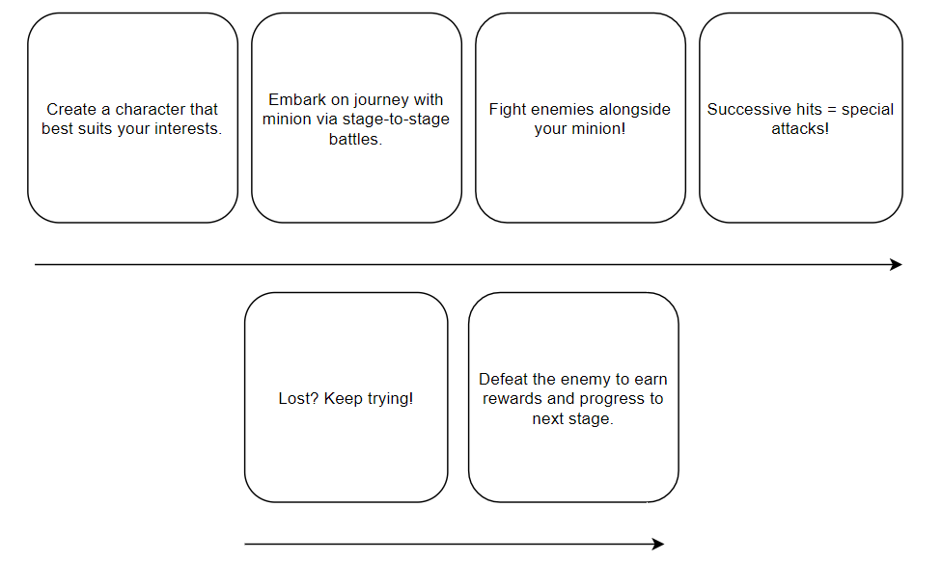
Early Game/Concept Pitch

Slide 6
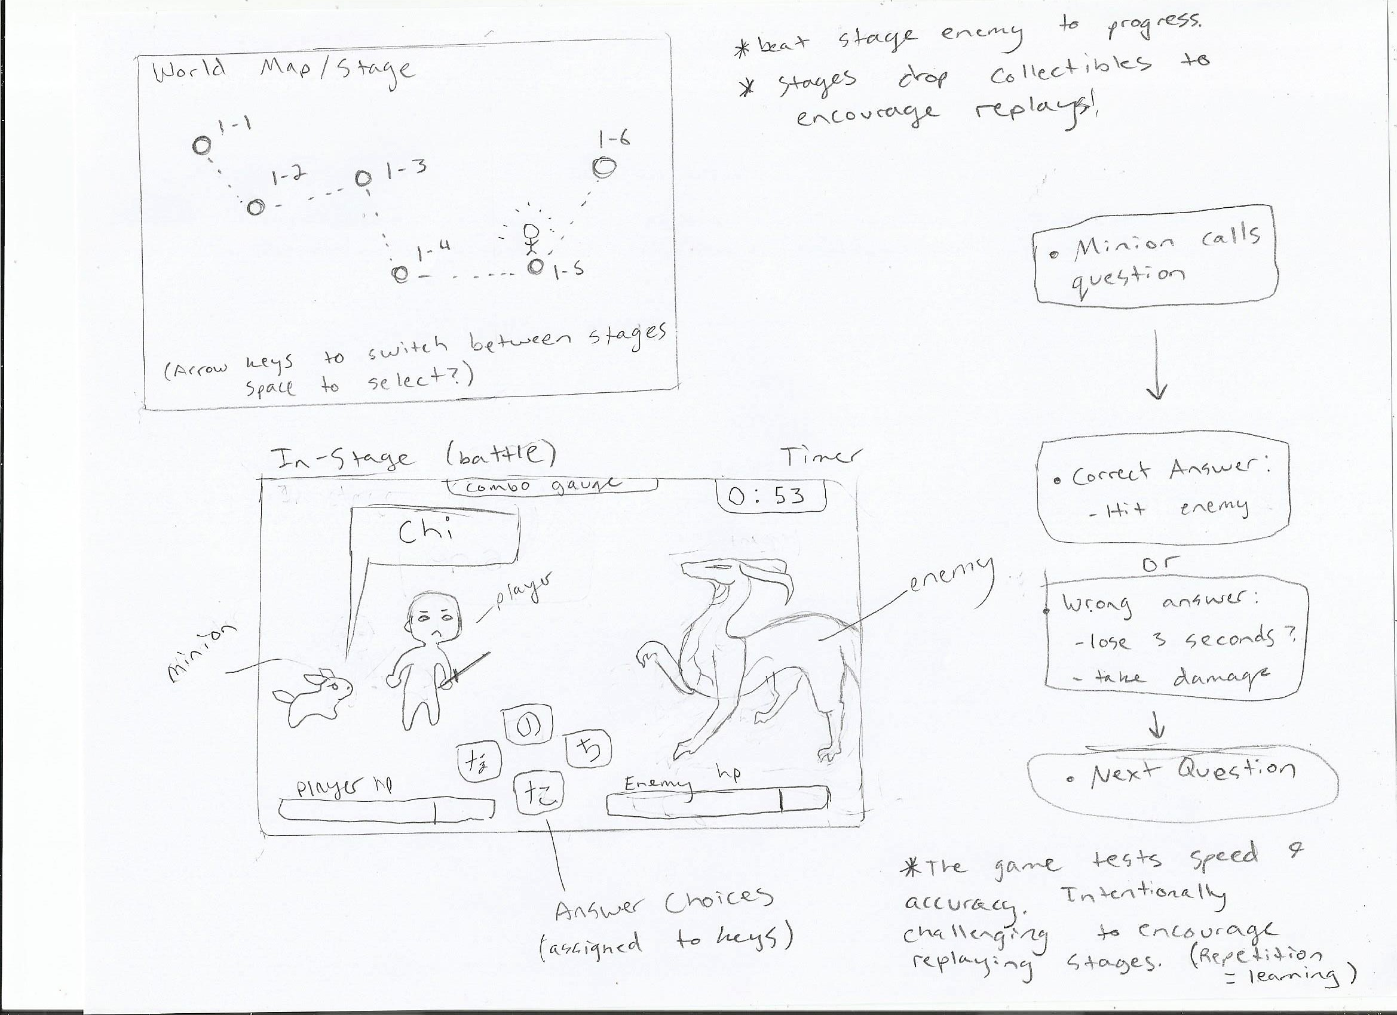

Slide 7
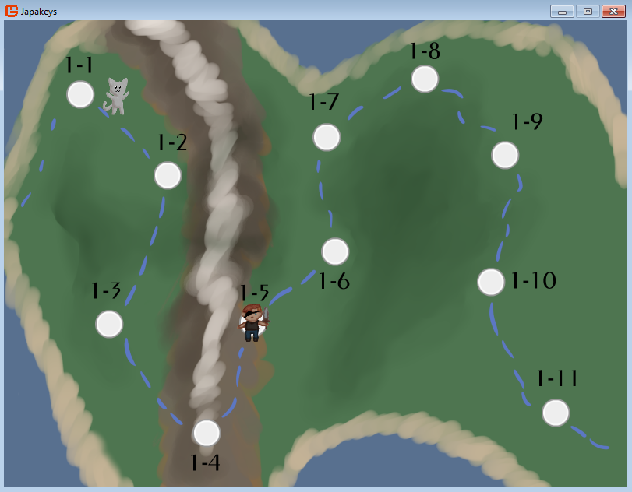
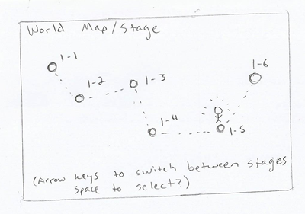
Early Concept Sketches vs Alpha Product

Slide 8
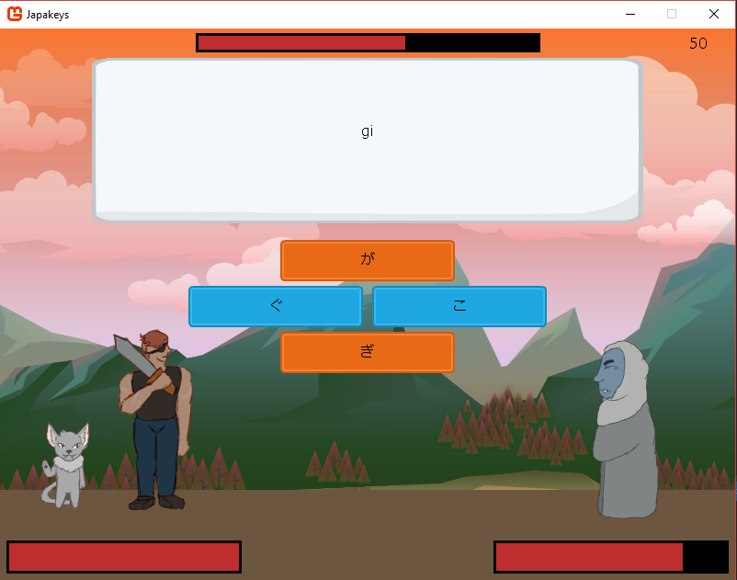
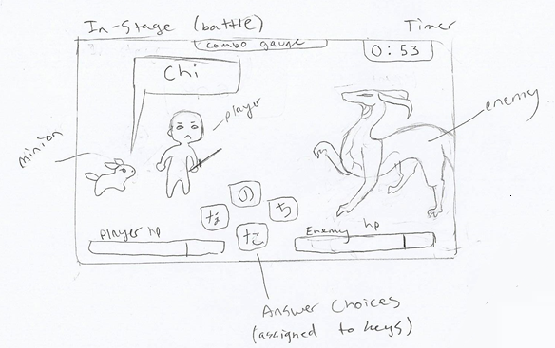
Early Concept Sketches vs Alpha Product

Slide 9
Demo Time!

Slide 10
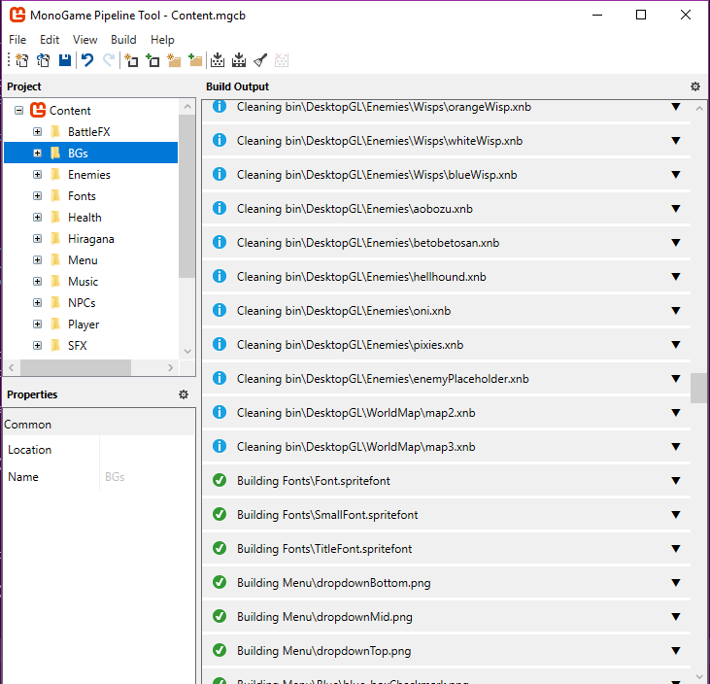
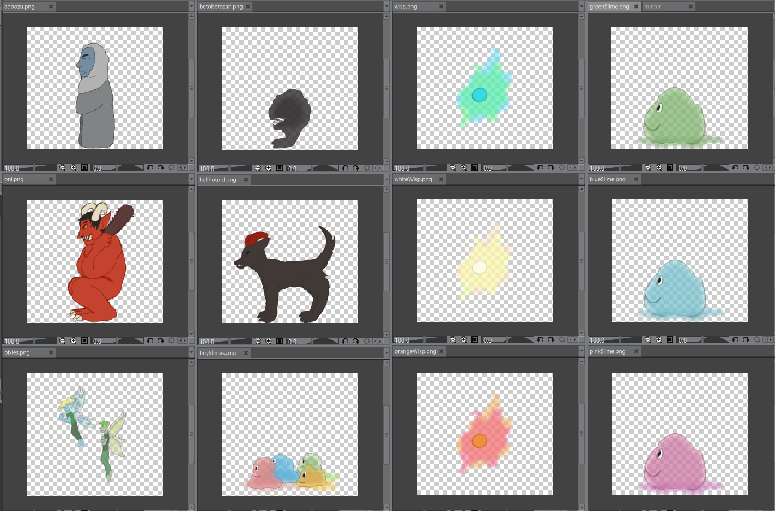
UI – Content management AND ASSETS
Multiple Hand-drawn Assets
MonoGame’s Content Manager

Slide 11
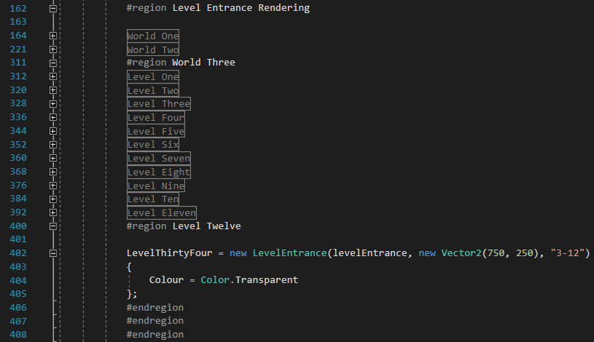
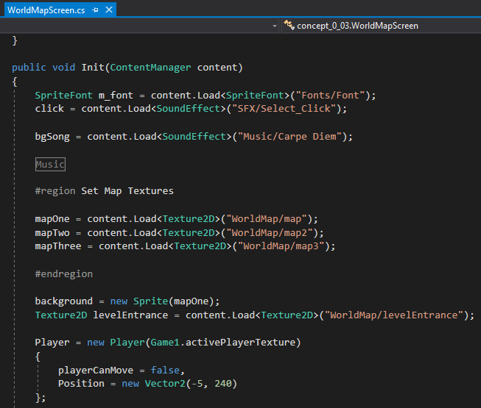
UI – displaying and positioning
Example of content loading code
Example of how the level entrances are positioned

Slide 12
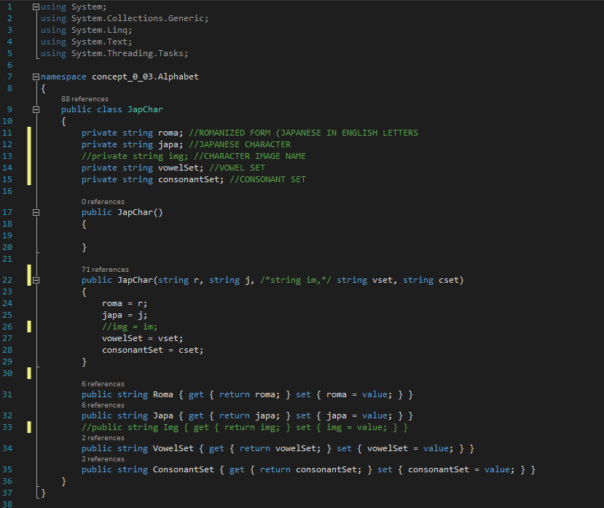
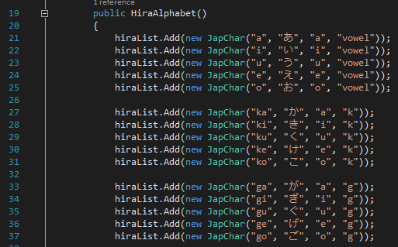
Constructing Questions
JapChar Class (Blueprint for a Japanese Character)
Master List for Japanese Characters (Populated with JapChar Objects)

Slide 13
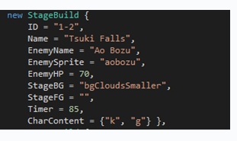
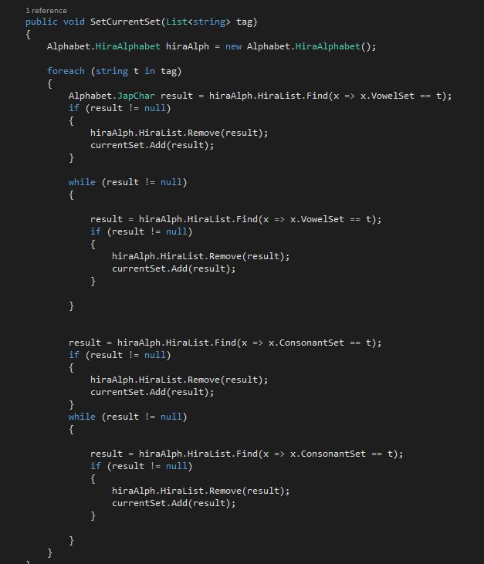
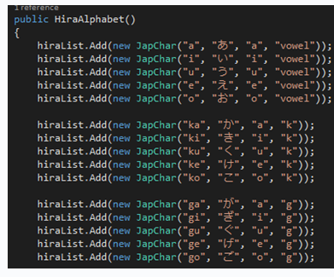
StageData Object
Fetches JapChar objects from master list whose tags match the called Stage’s CharContent tags
Searches both vowel and consonant tags while eliminating redundancy & null values.
The matching objects are put into a new list called CurrentSet
Master JapChar List

Slide 14
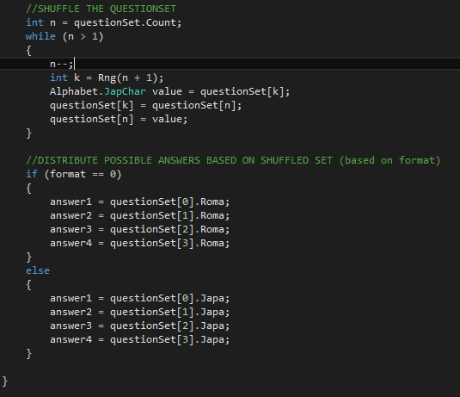
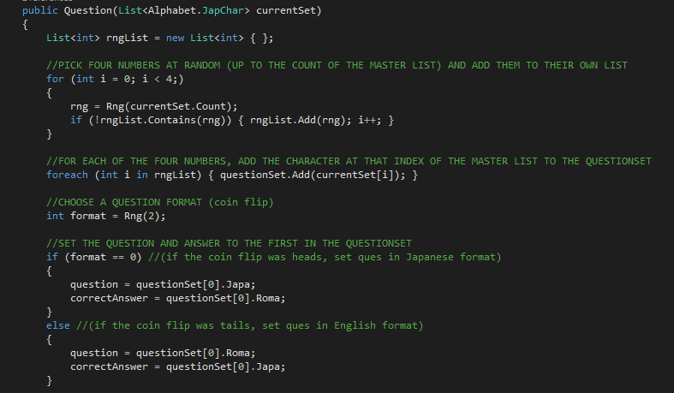
Question Construction Using CurrentSet

Slide 15
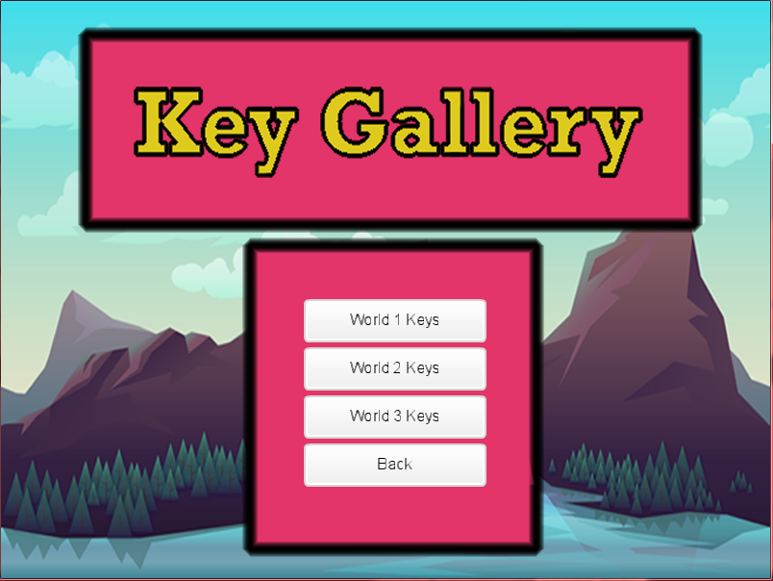
Key gallery: reward system
A system of achievements the player can strive to complete as they are playing the game.
Another reason for players to go back and replay levels rather than advance.
2 Sets of Achievements in the form of a Silver and Gold Key.

Slide 16
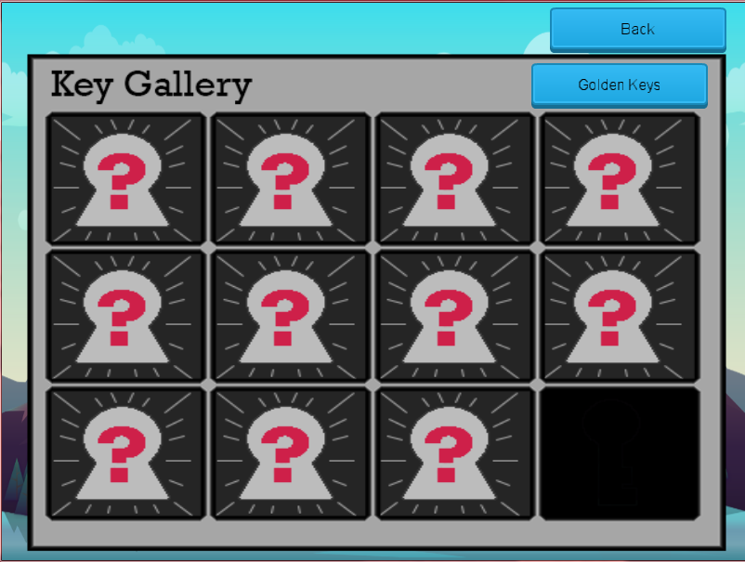
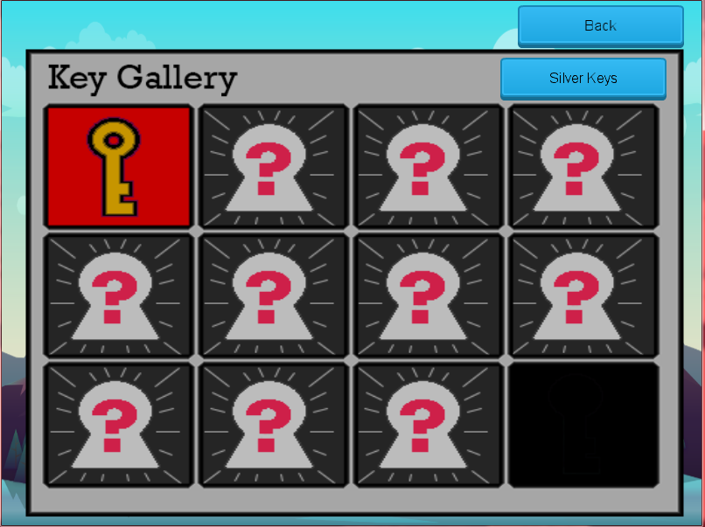
Breakdown of symbols
Black Square – This is a spot that has been filled in because there is a smaller number of levels than the amount of spots on the Gallery Frame.
Key (Silver or Gold) – This a key that has been awarded to the player by chance for completing the level.
Question Mark – The question mark is sign that there is a key that can be acquired for that level, but has not been acquired yet.

Slide 17
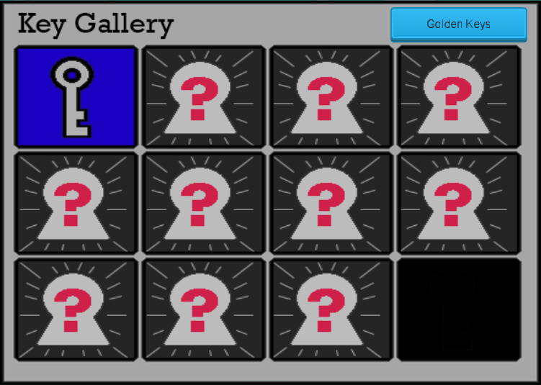
Since there are only 11 levels on World 1, one of the 12 slots has been blacked out.
Pressing either of these buttons will swap to the other list of keys.

Slide 18
An Internal Breakdown Of the system
The keys the player obtains are contained in an object that holds two lists(One for each of the 2 two types of keys) called “KeyInventory”.
This object is located/placed in the World Map as a public static object in order to be accessed from anywhere in the game.
KeyInventory instantiated as a static object above.
This Object contains:
SilverKeysList
GoldKeysList
These lists both contain key objects for every level with a Boolean variable set to false.
If set to false, a question mark square will appear in the gallery instead of a key square.

Slide 19
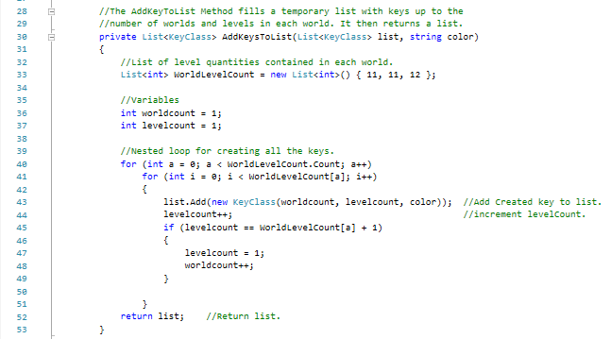
Creating the Lists of keys
This list of int values contains the number of levels on each world.
Ex: WorldLevelCount[0] = 11
This means World 1 has 11 levels.
These two variables control the nested loop below.
- wordcount is the current world key set being made.
- Levelcount is the current level on a world being made.
This nested loop creates Key objects that have all yet to be obtained. The number is determined by “worldcount” & “levelcount”. As a world is finished, worldcount is incremented allowing the next set to be made.

Slide 20
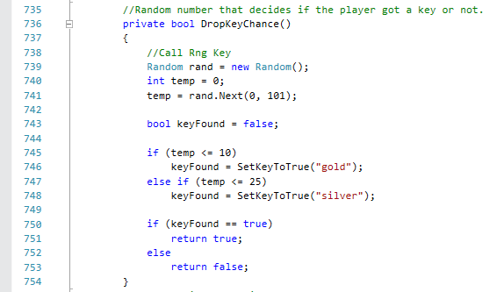
How to get a key
Getting a key takes a fair amount of luck as there a small chance of getting a Silver Key and an even smaller chance of getting a gold key.
Silver Keys – 25% Drop Chance
Gold Keys – 10% Drop Chance
This opportunity to obtain a key arises after a battle has been won
The function to the left picks a number from 0 to 100 and based on the result, a key of a certain color may be awarded.

Slide 21
Obstacles
MonoGame –Not Visual; hard-coded UI
Japanese Character integration in code
Database vs Listing – Japanese Characters
Merging via GitHub
Question Construction – RNG & Repetition
Handling Levels & Progression

Slide 22
Concepts That Didn’t Make It ++Future Potential
Saving/Loading a Game
Practice Mode
Character Choice affects Play
Fleshed out RPG Concepts
Kanji-based Collectibles
Story (Interaction with minion; purpose behind Adventure)
Android/iOS Capabilities
Added Languages

Slide 23
Why Japakeys?
Group interest in creating a game
Educational; solves a problem
Language considerations
Japanese + RPG: often the same target market

Slide 24
Assets & Credits
Music, Textures, & BGs were open-source, free assets from the web
Music: Aaron Krogh
https://rpgmaker.net/forums/topics/11322/
Textures: Kenney
https://kenney.nl/assets/ui-pack
BGs: Nastya Friday
https://www.reskin99.com/2018/02/free-horizontal-2d-game-backgrounds.html
World Maps, Sprites (Minion, Player, & Enemies) hand drawn by Matt Walsh

Slide 25
Question & Answer

